Slide 1
COMP 4500
Week 4 - Wednesday

Slide 2
Last time
What did we talk about last time?
Topological sort
Greedy algorithms
Interval scheduling

Slide 3
Questions?

Slide 4
Logical warmup
Two friends who live 36 miles apart decide to meet and start riding their bikes towards each other.
  They plan to meet halfway.
  Each is riding at 6mph.
  One of them has a pet carrier pigeon who starts flying the instant the friends start traveling.
  The pigeon flies back and forth at 18mph between the friends until the friends meet.
How many miles does the pigeon travel?

Slide 5
Scheduling all intervals
What if all intervals need to be scheduled?
  Example: Lectures are intervals and resources are classrooms
  Example: Roasting pigs are intervals and resources are fire pits
The problem is to find the minimum number of resources needed to satisfy all intervals
The book calls this problem interval partitioning

Slide 6
Interval partitioning: visualization
Intervals to schedule (arranged unhelpfully):
Intervals to schedule (arranged helpfully):
The depth d of a set of intervals is the maximum number that pass a single point on the time-line

Slide 7
Interval partitioning algorithm
Sort intervals by their start times
Let I₁, I₂, …, I_{n} be the ordered intervals
For j = 1, 2, 3, ..., n
  For each interval I_{i} that precedes I_{j} in sorted order and overlaps it
    Exclude the label of I_{i} from consideration for I_{j}
  If there is any label from {1, 2, …, d} that has not been excluded
    Assign that label to I_{j}
  Else
    Leave I_{j} unlabeled

Slide 8
Interval partitioning correctness
Claim: In our algorithm, every interval will be assigned a label, and no two overlapping intervals will receive the same label.
Proof: Consider interval I_{j}, and suppose there are t intervals earlier in the sorted order that overlap it. These t intervals with I_{j} form t + 1 intervals that pass over a common point on the time-line. Thus, t + 1 ≤ d and t ≤ d – 1. Thus, there must be at least one label left to be assigned to I_{j}.

Slide 9
Proof continued
To show that no two overlapping intervals are assigned the same label, consider two intervals I and I' that overlap. Suppose that I precedes I' in the sorted order. When I' is considered by the algorithm, I is in the set of intervals whose labels are excluded. ∎

Slide 10
Scheduling to minimize lateness
Consider a problem with requests that are not fixed in time
Instead, each request i has a deadline d_{i} and requires time t_{i} using the resources
If the finish time f(i) > d_{i}, its lateness l_{i} = f(i) – d_{i}
If the finish time f(i) ≤ d_{i}, its lateness l_{i} = 0
One goal we could have is to minimize the maximum lateness of any given job
  We don't care about the sum of the lateness, just the single job that is the most overdue

Slide 11
Scheduling example
Deadline = 2
Job 1:
Job 2:
Job 3:
Solution:
Lateness = 0
Deadline = 4
Deadline = 6

Slide 12
Designing the algorithm
Which request do we schedule next?
Shortest jobs first?
  No, we could have short jobs with late deadlines
Jobs with the least slack time (d_{i} – t_{i})
  No, consider Job 1 with t₁ = 1 and d₁ = 2 and Job 2 with t₂ = 10 and d₂ = 10
Sort by order of increasing deadlines?
  Surprisingly, yes! Length of job doesn't matter

Slide 13
Minimizing lateness algorithm
Sort the jobs in increasing order of deadlines
For simplicity, relabel jobs and deadlines so that d₁ ≤ d₂ ≤ … d_{n}
Set f = s
For i = 1, 2, …, n
  Assign job i to the interval from s(i) = f to f(i) = f + t_{i}
  Set f = f + t_{i}

Slide 14
Observations
Idle time is time when no jobs are scheduled but there are still jobs left (gaps)
There is an optimal schedule with no idle time
We will use an exchange argument to transform the optimal schedule O into the schedule A we produce
We say that a schedule has an inversion if a job i with deadline d_{i} is scheduled before a job j with an earlier deadline d_{j} < d_{i}
  Our algorithm produces a schedule with no inversions

Slide 15
All schedules with no inversions and no idle time have the same maximum lateness
Proof:
  If two different schedules have neither inversions nor idle time, they might not produce the same order of jobs, but they can only differ in the order in which jobs with identical deadlines are scheduled.
  Consider such a deadline d. In both schedules, the jobs with deadline d are all scheduled consecutively (after all jobs with earlier deadlines and before all jobs with later deadlines). Among the jobs with deadline d, the last one has the greatest lateness, and this lateness does not depend on the order of the jobs. ∎

Slide 16
There is an optimal schedule with no inversions and no idle time
Proof:
  We know there is an optimal schedule O with no idle time.
  If O has an inversion, then there is a pair of jobs i and j such that j is scheduled right after i and has d_{j} < d_{i}.
  If there were no inversions, all of the deadlines would be in order, but the fact that there is an inversion means that some point will be reached where a job has an earlier deadline than the job before it. Let that job be i and the previous job be j.
  If we swap i and j, we get a schedule with one fewer inversion.

Slide 17
Illustration of jobs i and j
Original schedule O (before swapping)
Schedule O' (after swapping)
Nothing other than i and j are affected
Job i
Job j
Job j
Job i

Slide 18
Proof continued
This new swapped schedule has a maximum lateness no larger than that of O.
Why?
Since there are no gaps, the only things affected are jobs i and j. (Nothing before or after changes.)
Job j is finishing earlier, so its lateness will not increase.
We will use a prime (') to differentiate quantities in the swapped schedule.
Now, f'(i) = f(j) and remember that d_{i} > d_{j}
l_{i}' = f(j) – d_{i} < f(j) – d_{j} = l_{j}
The old maximum lateness L ≥ l_{j} > l_{i}'
Thus, the new maximum lateness L' will not be greater
∎

Slide 19
Our greedy algorithm is optimal
Claim:
  The schedule A produced by the greedy algorithm has optimal maximum lateness.
Proof:
  The previous proof shows that we can construct a schedule without inversions as good as any optimal one with inversions.
  The proof before that says that all schedules with no inversions and no idle time have the same maximum lateness.
  Since our algorithm finds a schedule without inversions and no idle time, it must be optimal. ∎

Slide 20
Three-Sentence Summary of Shortest Paths and Minimum Spanning Tree

Slide 21
Shortest Paths

Slide 22
Shortest path set up
Directed graph G = (V, E) with start node s
Assume that there is a path from s to every other node (although that's not critical)
Every edge e has a length l_{e} ≥ 0
For a path P, length of P l(P) is the sum of the lengths of the edges on P
We want to find the shortest path from s to every other node in the graph
An undirected graph is an easy tweak

Slide 23
Designing the algorithm
Let's first look at the length of the paths, not the actual paths
We keep set S of vertices to which we have determined the true shortest-path distance
  S is the explored part of the graph
Then, we try to find the shortest new path by traveling from any node in the explored part S to any node v outside
We update the distance to v and add v to S
Then, continue

Slide 24
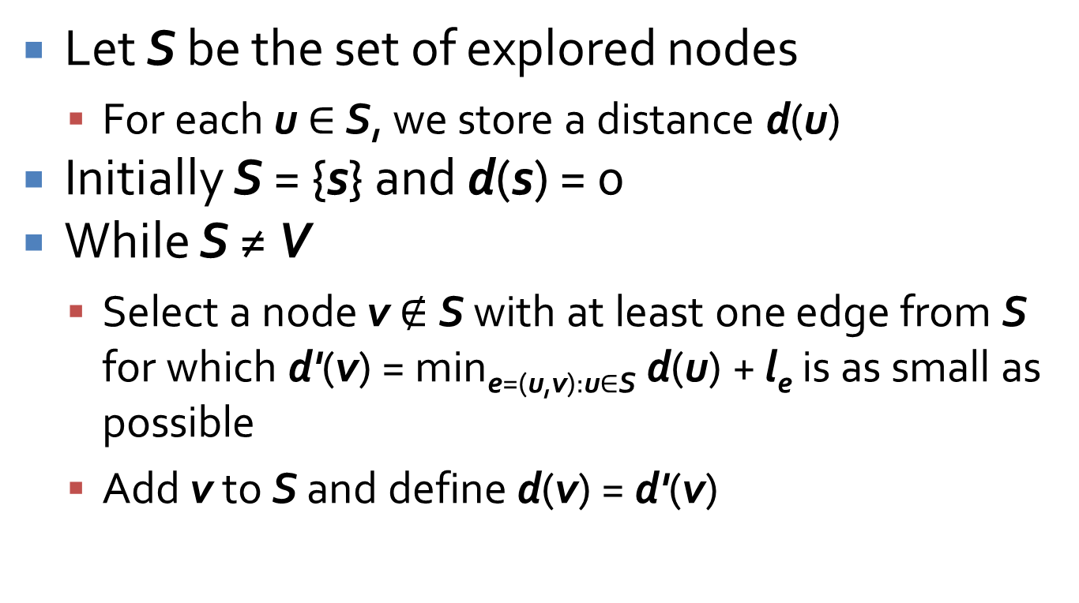
Dijkstra's algorithm
Let S be the set of explored nodes
  For each u ∈ S, we store a distance d(u)
Initially S = {s} and d(s) = 0
While S ≠ V
  Select a node v $∉$S with at least one edge from S for which d'(v) = min_{e=(u,v):u∈S} d(u) + l_{e} is as small as possible
  Add v to S and define d(v) = d'(v)

Slide 25
Dijkstra's algorithm example
3
C
B
2
4
J
2
9
3
A
6
8
13
F
2
3
7
I
D
H
4
17
3
4
G
E
1

Slide 26
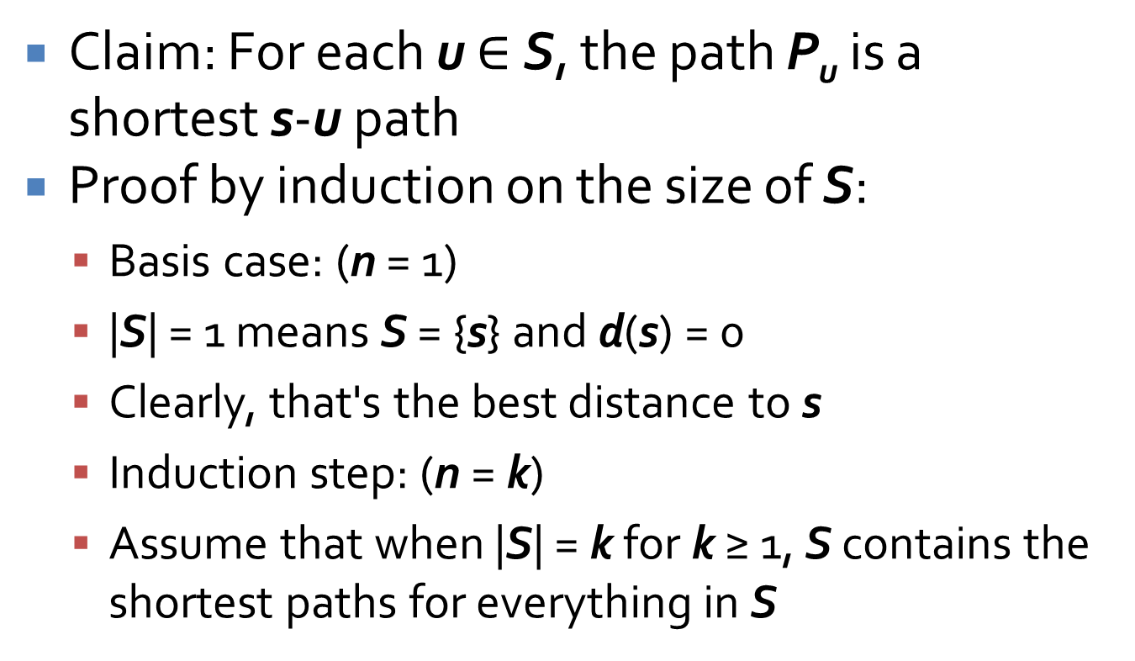
Consider S at any point during the algorithm
Claim: For each u $∈$ S, the path P_{u} is a shortest s-u path
Proof by induction on the size of S:
  Basis case: (n = 1)
  |S| = 1 means S = {s} and d(s) = 0
  Clearly, that's the best distance to s
  Induction step: (n = k)
  Assume that when |S| = k for k ≥ 1, S contains the shortest paths for everything in S

Slide 27
Proof continued
Suppose we are increasing S to size k + 1 by adding node v. Let (u, v) be the final edge on our s-v path P_{v}.
By the induction hypothesis, P_{u} is the shortest s-u path for all u ∈ S.
Consider any other s-v path P. Since v is not in S, P must leave S somewhere. Let y be the first node on P that is not in S, and let x ∈ S be the node just before y.

Slide 28
Proof continued
On step k + 1, we could have added y, but we didn't. Thus, there is no path from s to y through x that is shorter than P_{v}.
But the subpath of P up to y is such a path, so that subpath must be at least as long as P_{v}. Since edge lengths are nonnegative, P is at least as long as P_{v}.
Thus, P_{v} must be the shortest path to v. ∎

Slide 29
Reflections on Dijkstra's algorithm
You can think of Breadth-First Search as a pulse expanding, layer by layer, through a graph from some starting node
Dijkstra's algorithm is the same, except that the time it takes for the pulse to arrive is based not on the number of edges, but the lengths of the edges it has to pass through
Because Dijkstra's algorithm expands from the starting point to whatever is closer, it grows like a blob
There are algorithms that, under certain situations, can cleverly grow in the direction of the destination and will often take less time to find the path there

Slide 30
Running time for Dijkstra's algorithm
For n nodes, the While loop runs n – 1 times
In the worst case, we might need to look at all the edges to compute appropriate minima for each iteration
  Yielding a running time of O(mn)
It turns out that using a priority queue allows us to get the time down to O(m log n)
  Some deep data structure work has been done here, and I don't want to go into it
  Read the literature if you want to implement the algorithm as fast as possible

Slide 31
Quiz

Slide 32
Upcoming

Slide 33
Next time…
Finish Dijkstra's
Minimum spanning trees
Review

Slide 34
Reminders
Finish Assignment 2
  Due Friday before midnight
Review chapters 1 through 3
Exam 1 is next Monday
All office hours are canceled today

